Slide 1

Data Structure Visualization
Data Structure implementation using java

Slide 2
Project Team
Eman Mamdouh
Fatma Mohamed
Rowan Omar
Supervised by:
Prof. Dr. Mahmoud Ali

Slide 3
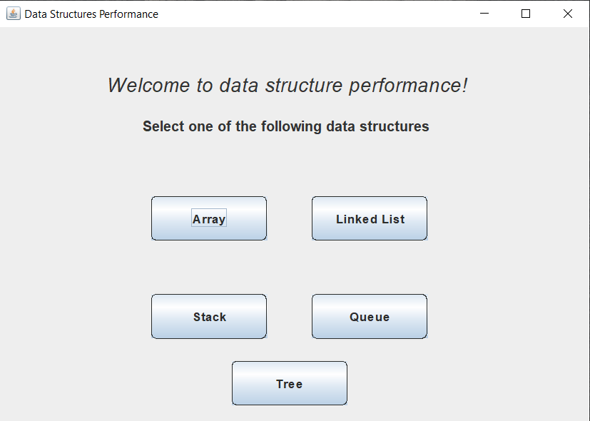
Project entry window
When the user runs the program, a start window of the program appears.
Here, the user is capable of selecting different data structures and some with different implementations to see their performance to help selecting “best” data structure.
The user can enter either strings or integers in his/her selected data structure and they are informed when something goes wrong.
We need to mention that if the user wants to perform the removal operation, they must do the removal before adding any new item.
The time consumed is measured after each operation for the selected data structure, to help compare how much would it take to perform an operation in each data structure.

Slide 4
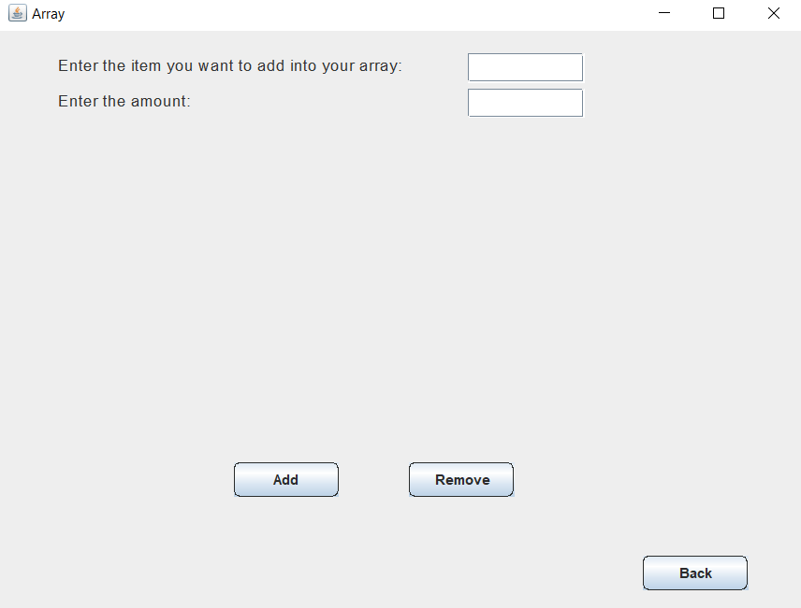
Array Data Structure
If the user selects the array data structure, a window will appear where the user could do some operations on that data structure.
If the user is to choose to add an item, he/she needs to enter that item in the first text field, and how many times this item will be repeated in the array in the second text filed.

Slide 5
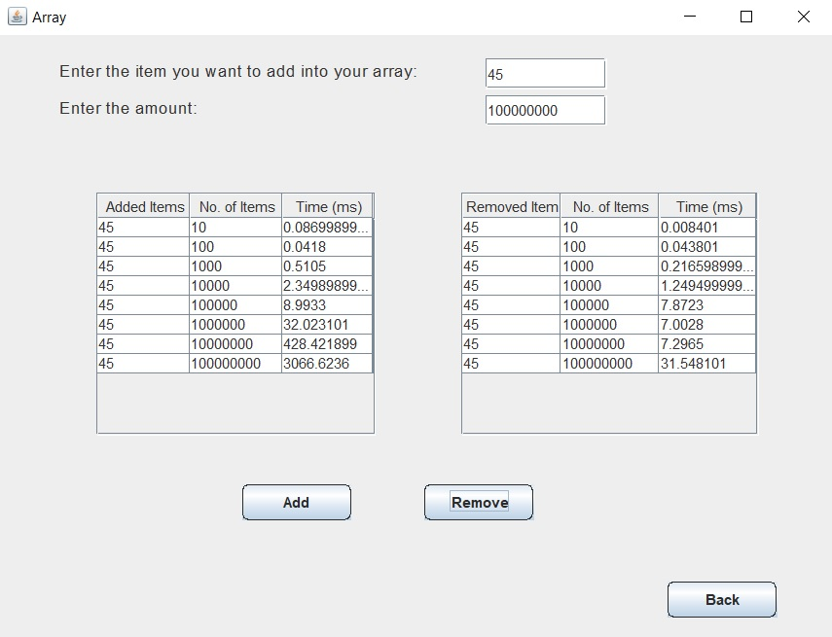
Array Data Structure (Cont’d)
If, for example, the user enters the number 45 and to be added these many times as shown in the figure, he/she will be able to see that item with the entered amount are added, and the time taken to perform each insertion operation.
We need to mention that the insertion operations happen in the last place available in the array. And the removal operations happen in the last, actually filled position in the array.
This gives time complexity that is O(1) since we are not required to sort the elements.

Slide 6
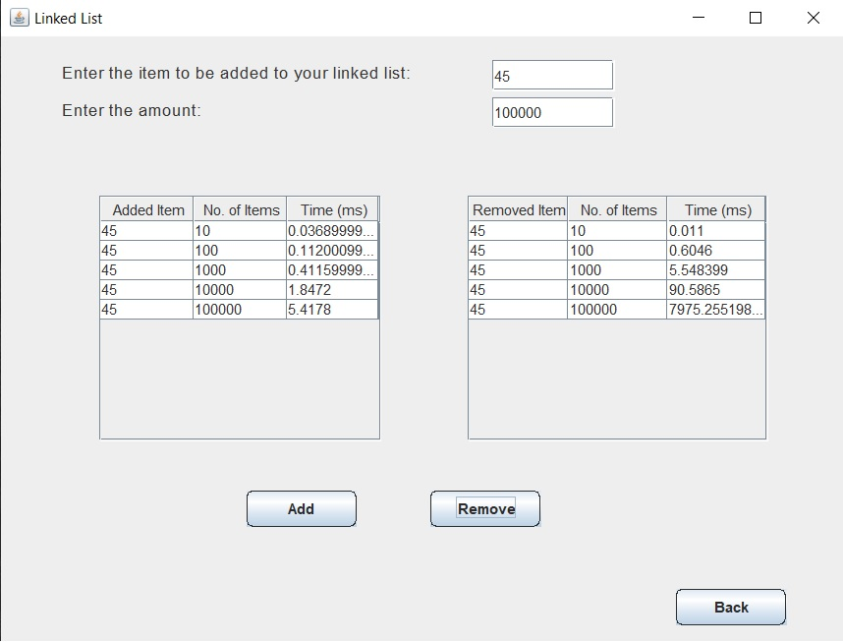
Linked List Data Structure
If the user has chosen the linked list data structure for his explorations, he would also nearly the same window as in the array structure.
Here, the insertion operation in each time is done in the last available place in the linked list and thus taking O(1) as time complexity since we are using a reference to the end node of the list.
For the removal operation, although we are using a reference to the node just before the last node but the time complexity is O(n).

Slide 7
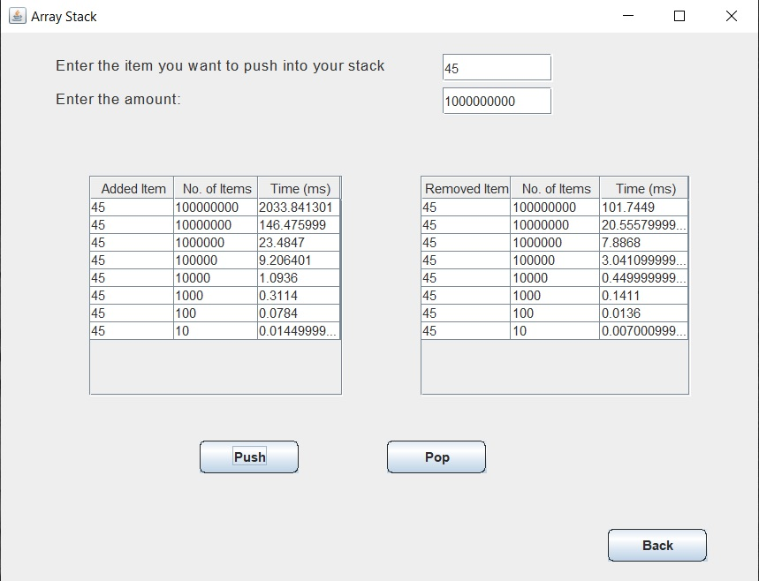
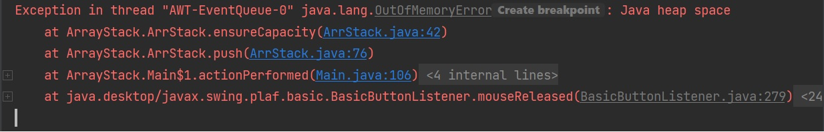
Stack Data Structure (Array Implementation)
Now, the user has chosen the stack data structure specifically the array implementation of the stack.
The stack as you know it is called LIFO data structure, which means the last pushed item is the first to be removed. So adding and removing is at the same end.
For the insertion operation, we would get time complexity as O(1). In addition, for the removal operation, we would have time complexity as O(n).
However, we would find that we get “OutOfMemoryError” when trying to add the number “45” 10^9 many times. This is because the array structure adds the elements in contiguous places in the memory and all the available places in memory are filled.

Slide 8
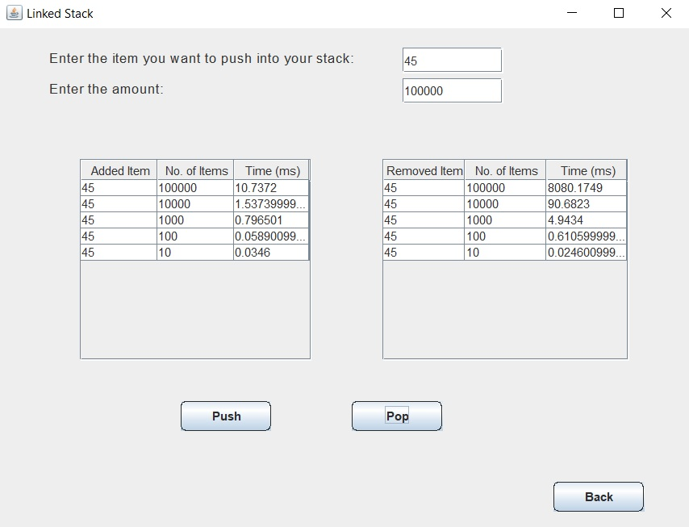
Stack (Linked List Implementation)
For the linked list implementation of the stack, for the insertion operation, we would get time complexity as O(1).
In addition, for the removal operation, we would have time complexity as O(1).
//Here the programs stops for the 10^5 times

Slide 9
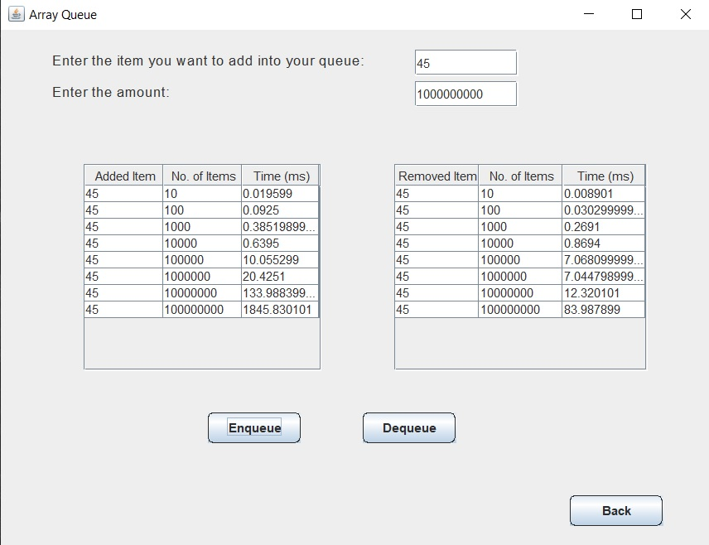
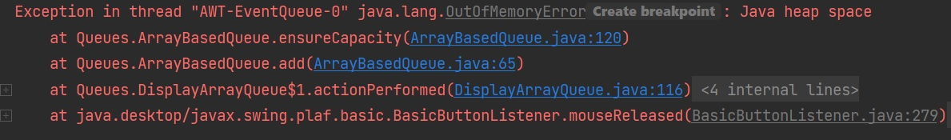
Queue Data Structure (Array Implementation)
Here is the queue data structure by the array implementation.
The queue is called FIFO data structure, which means the first added item is the first to be removed. Here adding and removing are at opposite sides.
For the insertion operation, we would get time complexity as O(1).
In addition, for the removal operation, we would have time complexity as O(1).
However, we would find that we get “OutOfMemoryError” when trying to add the number “45” 10^8 many times. The same as with the stack implementation using arrays.

Slide 10
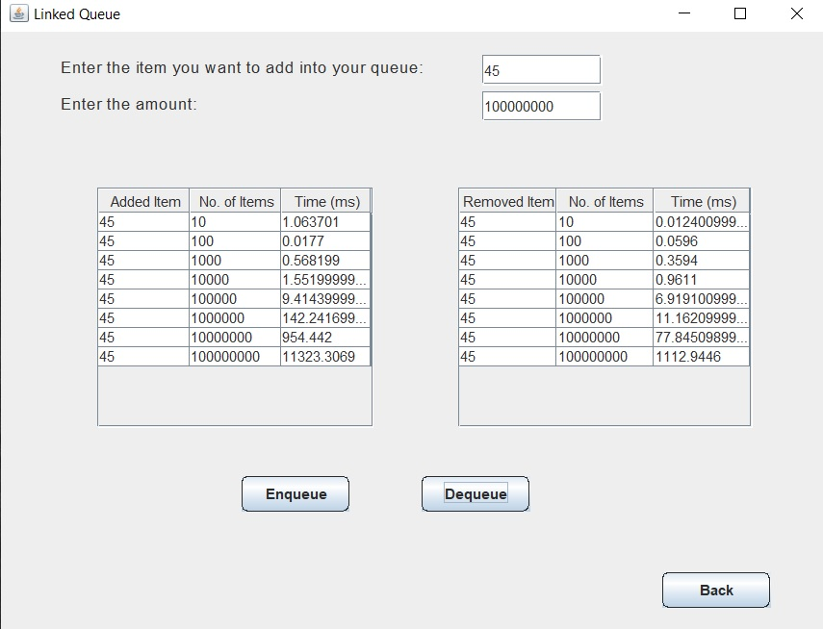
Queue (Linked List Implementation)
For the linked list implementation of the queue, for the insertion operation, we would get time complexity as O(1).
In addition, for the removal operation, we would have time complexity as O(1).

Slide 11
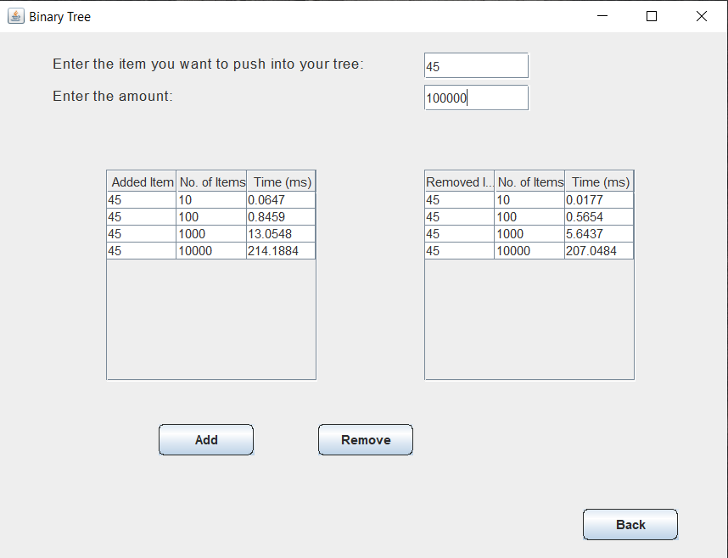
Binary Tree
For the binary tree data structure, for the insertion operation, and removal operation with their time execution for each operation.
Note that here the removal operation is done by removing the left most node.
The user will get “StackOverflowError”, when he/she enters the “45” 10^4 many times.

Slide 12
Array VS Linked List Insertion Operation
Conclusion: for the same number of inputs, the linked list is slower. This is because the huge memory locations needed for the linked list

Slide 13
Array Stack VS Linked List Stack Insertion Operation
Conclusion: for the same number of inputs, the linked list is slower. This is because the huge memory locations needed for the linked list

Slide 14
Array Queue VS Linked List Queue Insertion Operation
Conclusion: for the same number of inputs, the linked list is slower. This is because the huge memory locations needed for the linked list

Slide 15
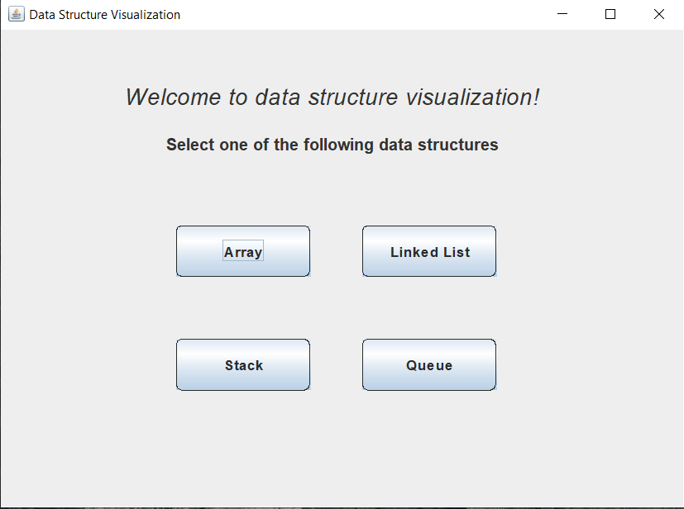
Visualization Project
Here, as in the previous program, the user is able to select different data structures to see the structure visualization and can use it for his/her usage.
The user can enter either strings or integers in his/her selected data structure and they are informed when something goes wrong.
The use is capable of performing the insertion and removal operations, and to get the first element, or the size of their data structure.

Slide 16
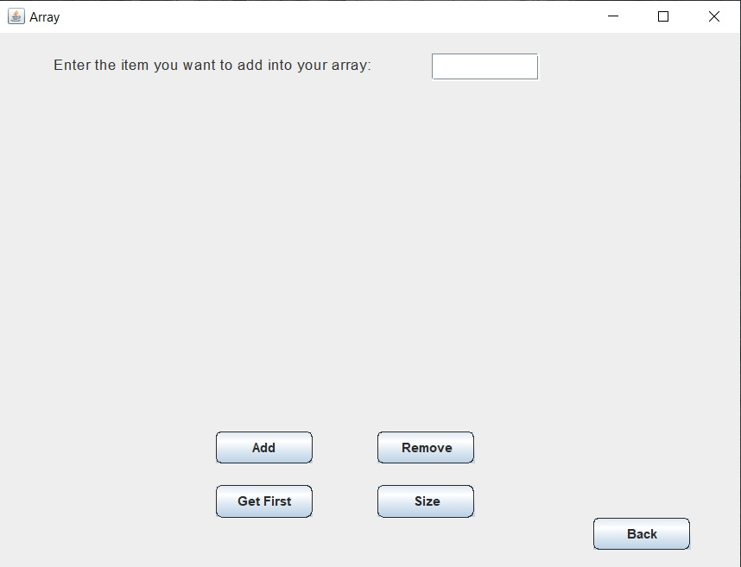
Array Data Structure
If the user selects the array data structure, a window will appear where the user could do some operations on that data structure.
If the user is to choose to add an item, he/she needs to enter that item in the text field, and a table will be viewed with the added item and the time for that as well as the visualization of the array being side by side.

Slide 17
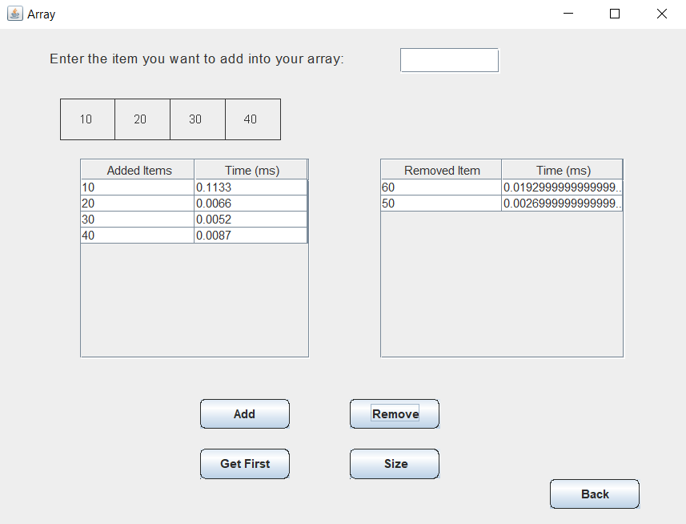
Array Data Structure (Cont’d)
If the user, for example, adds the integers from 10 to 60, then clicks the remove button twice, the result will be as shown in the figure.
The insertion operations happen in the last place available in the array. And the removal operations happen in the last, actually filled position in the array.
This gives time complexity that is O(1) since we are not required to sort the elements.

Slide 18

Linked List Data Structure
For the linked list, the insertion operation in each time is done in the last available place in the linked list and thus taking O(1) as time complexity since we are using a reference to the end node of the list.
For the removal operation, although we are using a reference to the node just before the last node but the time complexity is O(n).

Slide 19
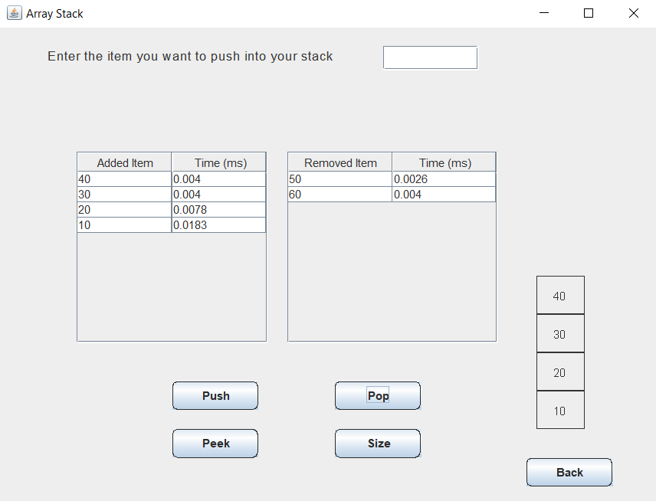
Stack Data Structure (Array Implementation)
For the stack implemented by the array data structure.
In the stack data structure, the insertion and removal is at the same end.
For the insertion operation, we would get time complexity as O(1). In addition, for the removal operation, we would have time complexity as O(1).

Slide 20
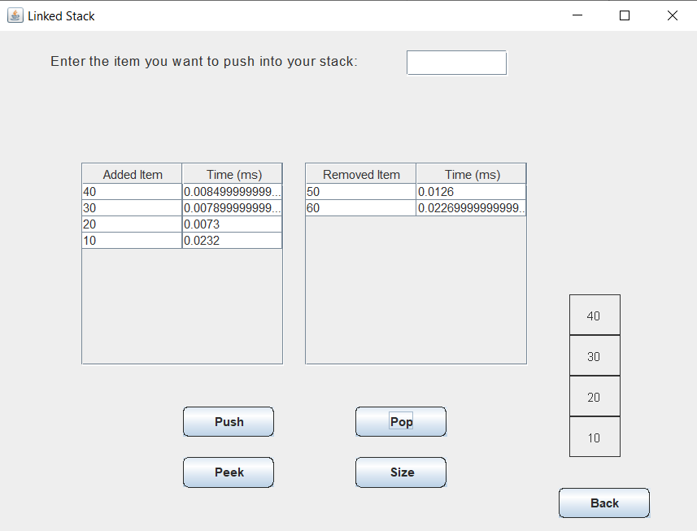
Stack (Linked List Implementation)
For the linked list implementation of the stack, for the insertion operation, we would get time complexity as O(1).
In addition, for the removal operation, we would have time complexity as O(1).

Slide 21
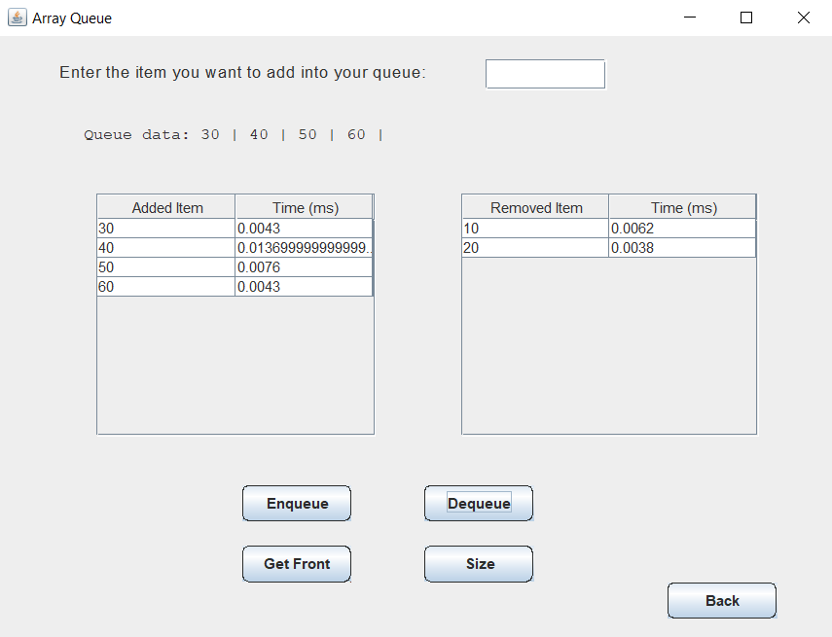
Queue Data Structure (Array Implementation)
Here is the queue data structure by the array implementation.
For the queue, insertion and removal operations are performed at opposite sides.
For the insertion operation, we would get time complexity as O(1).
In addition, for the removal operation, we would have time complexity as O(1).

Slide 22
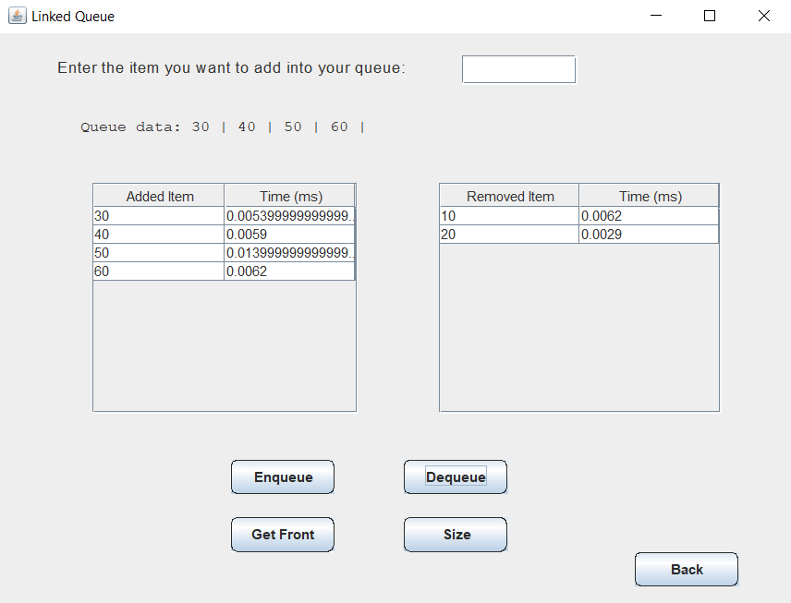
Queue (Linked List Implementation)
For the linked list implementation of the queue, for the insertion operation, we would get time complexity as O(1).
In addition, for the removal operation, we would have time complexity as O(1).

Slide 23
The End
Thank You!

